Slide 1
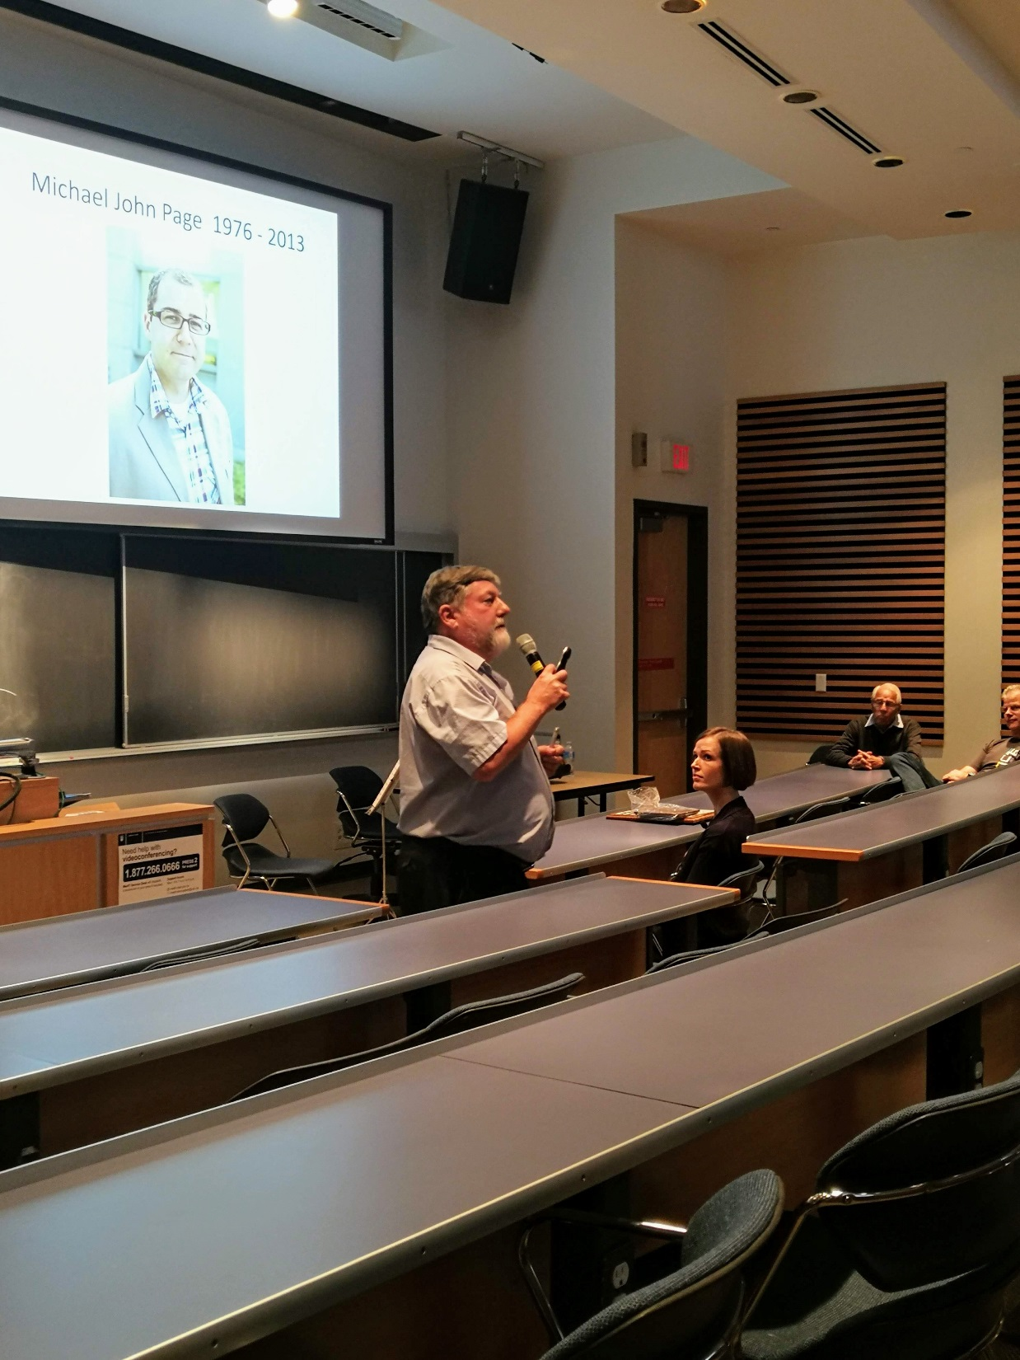
Dr. Ross MacGillivray
(Professor Emeritus, BMB and member of CBR)

Slide 2
Dr. Jennifer Grants (2018 Awardee of the Michael John Page Postdoctoral Fellow Award)

Slide 3
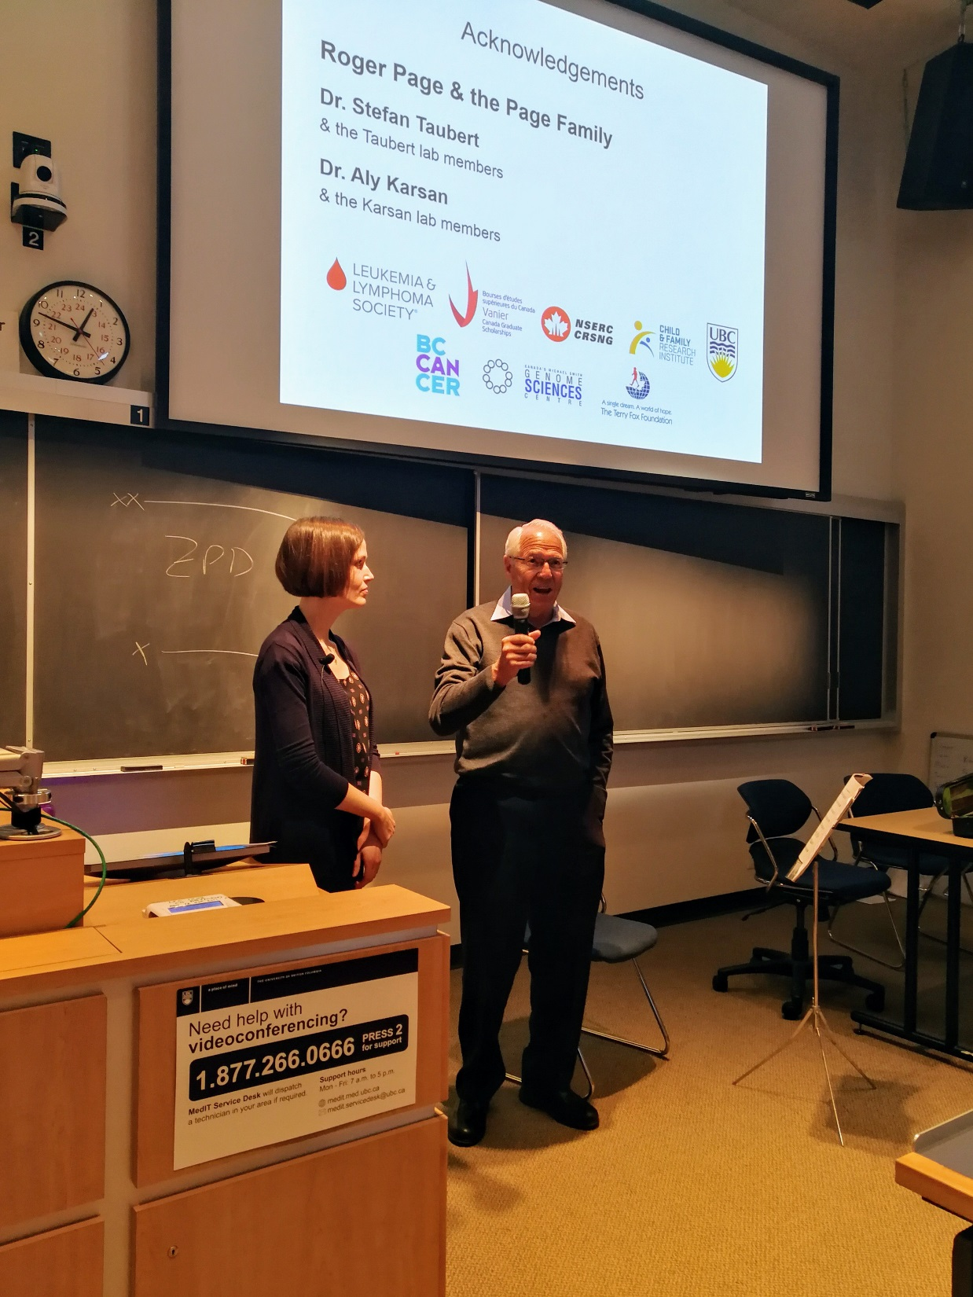
Dr. Jennifer Grants and Mr. Roger Page (Michael’s father who flew in from Thunder Bay)

Slide 4
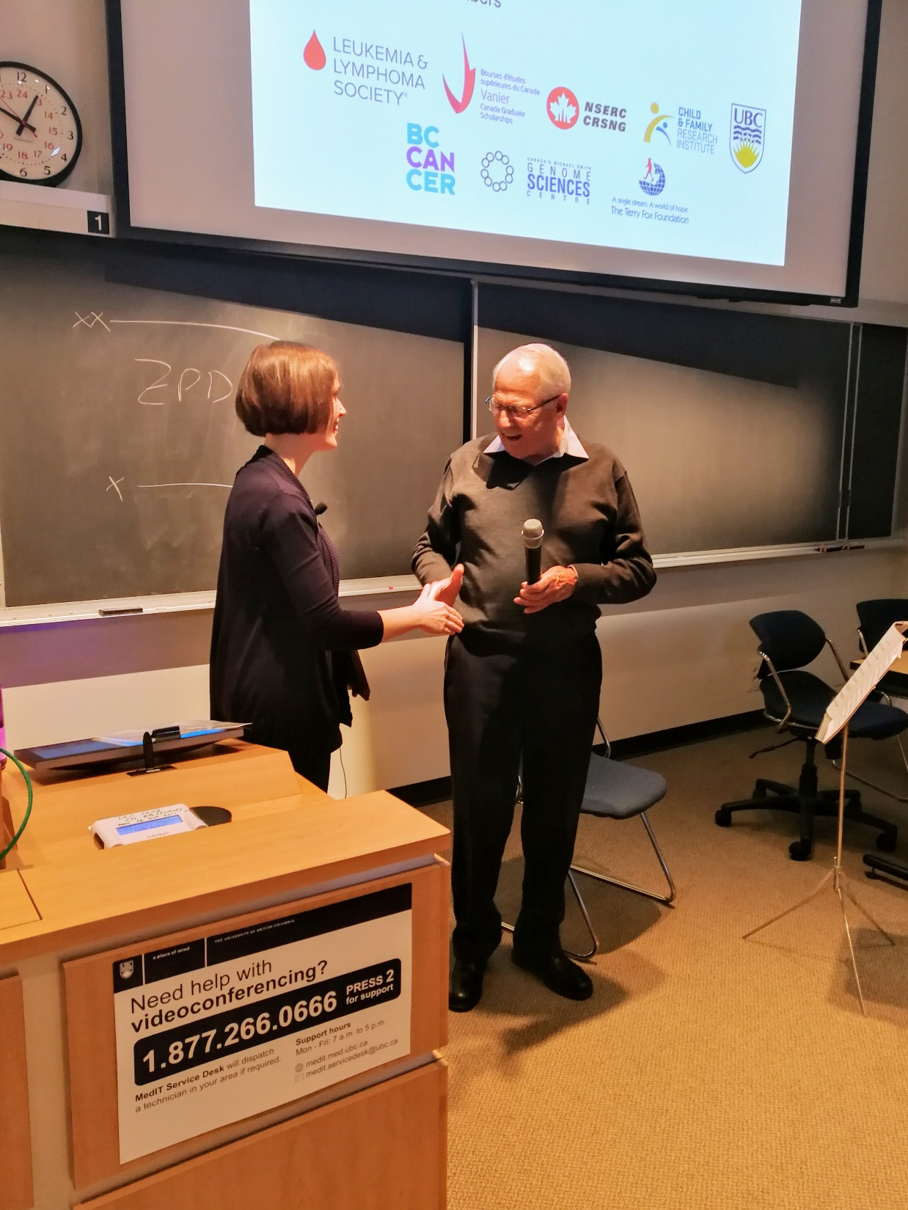
Dr. Jennifer Grants and Mr. Roger Page

Slide 5
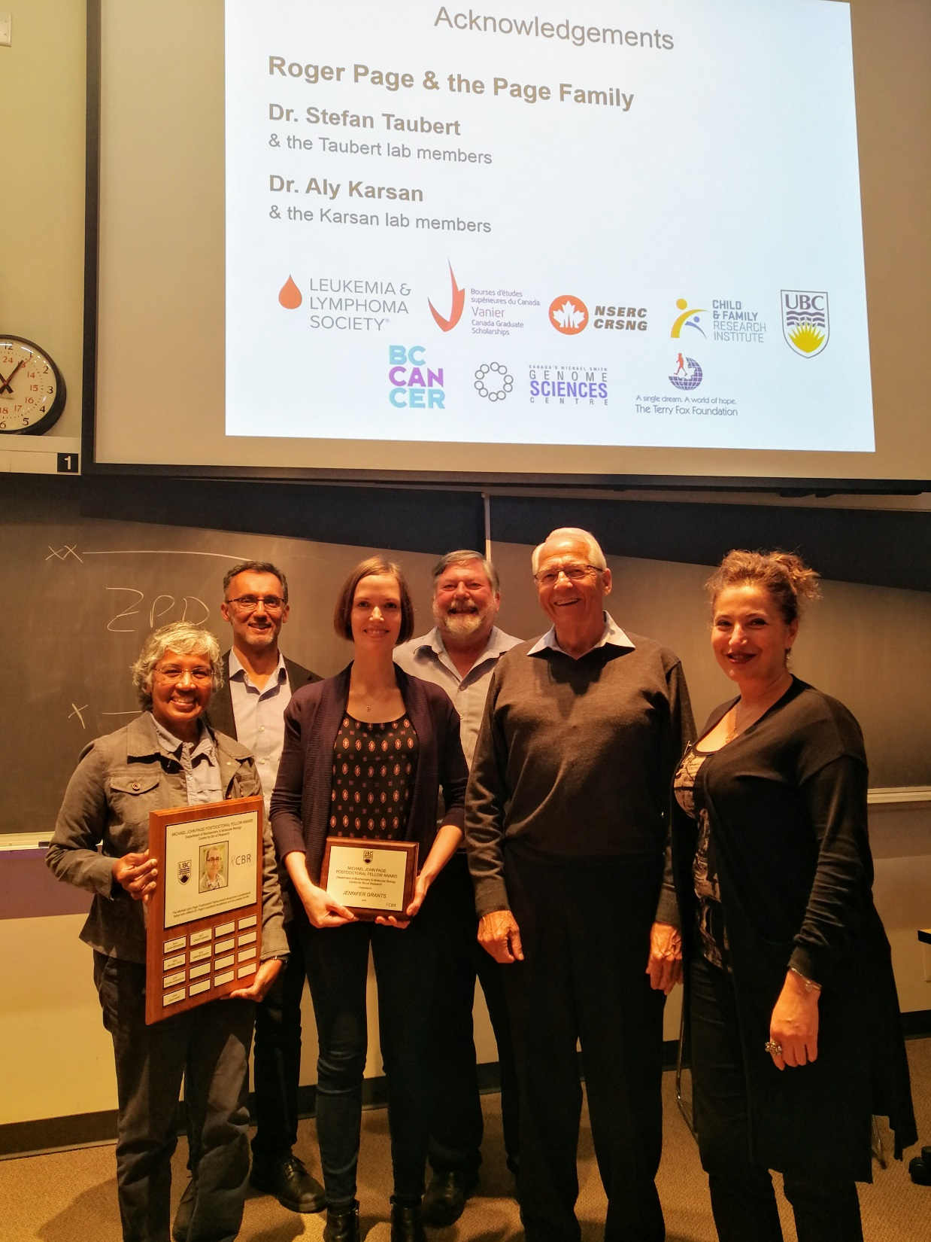
(left to right)
Dr. Rachel Fernandez (Associate Dean, Postdoctoral Fellows Office & Student Professional Development, Faculty of Graduate and Postdoctoral Studies)
Dr. Aly Karsan (Professor of Pathology & Laboratory Medicine, Dr. Grants’ postdoctoral supervisor and member of CBR)
Dr. Jennifer Grants
Dr. Ross MacGillivray
Mr. Roger Page
Ms Hourik Khanlian (Manager, Human Resources and Postdoctoral Affairs, Faculty of Graduate and Postdoctoral Studies)

