Slide 1
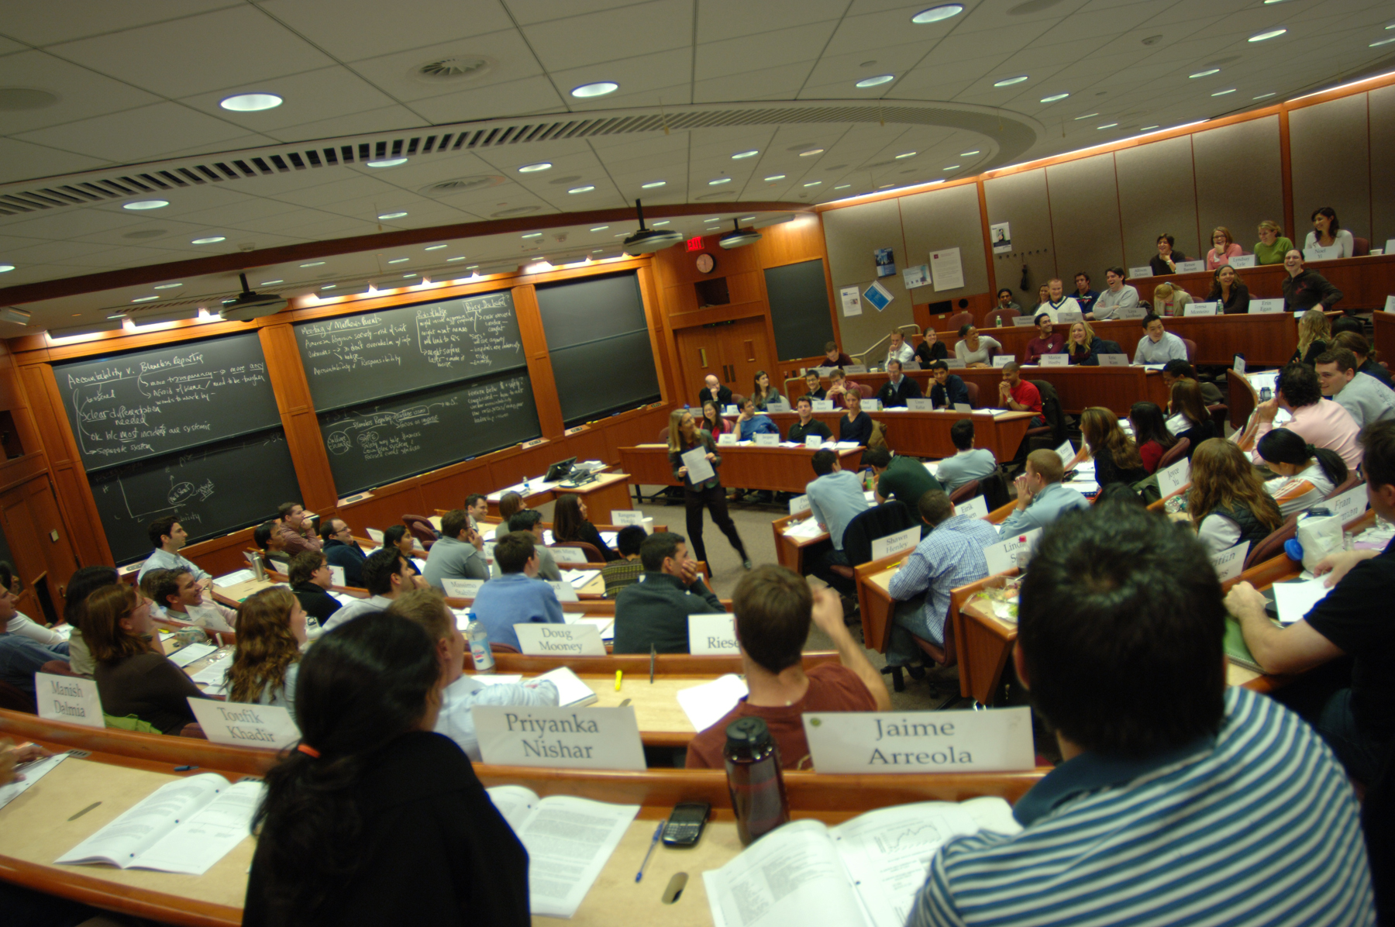
Biochemistry and Molecular Biology
Vancouver Summer Program
Instructor Training Program
“Full teaching experience, mentorship and get paid!” – 2015 Instructor Trainee
Interested in gaining an in-depth teaching experience?
What goes into executing a successful University course?
Are you a Post-Doctoral Fellow?
Note: Senior Graduate Student also considered in some exceptional cases
Instructor trainees will:
Develop course content with flexibility (April to mid-July, 2016)
Environmental Biochemistry &
Molecular Mechanisms of Disease
Deliver content to 40-60 students (mid-July to mid-August, 2016)
Experience a comprehensive teaching platform
course design & teaching tools (audio/visual technology, webCT)
student evaluation of learning
manage TA’s
Receive mentorship from the Teaching Faculty
insight to pedagogical approaches
Information Night:
5:30pm November 18, 2015
LSC 1330
Topics:
Program layout & 2016 timeline
How can I teach while juggling my research obligations?
Your questions!
Candidate interviews to commence in January 2016
Hosted by BMB Instructors:
Michael Krisinger and Scott Covey

